Slide 1
Reducing the Energy Consumption of IT Infrastructure
Latest Recommendations from VMware
VMware Cross-Cloud Services
Content Owner: Daniel Flaherty
2023
Notes:
Click to add notes

Slide 2
What’s driving the urgency for energy reduction?
Recommendation #1: Audit for Waste and Resource Optimization
Recommendation #2: Offload to Data Processing Units (DPUs)
Recommendation #3: Replace On-Site Disaster Recovery with DRaaS
Resources and additional solutions

Slide 3
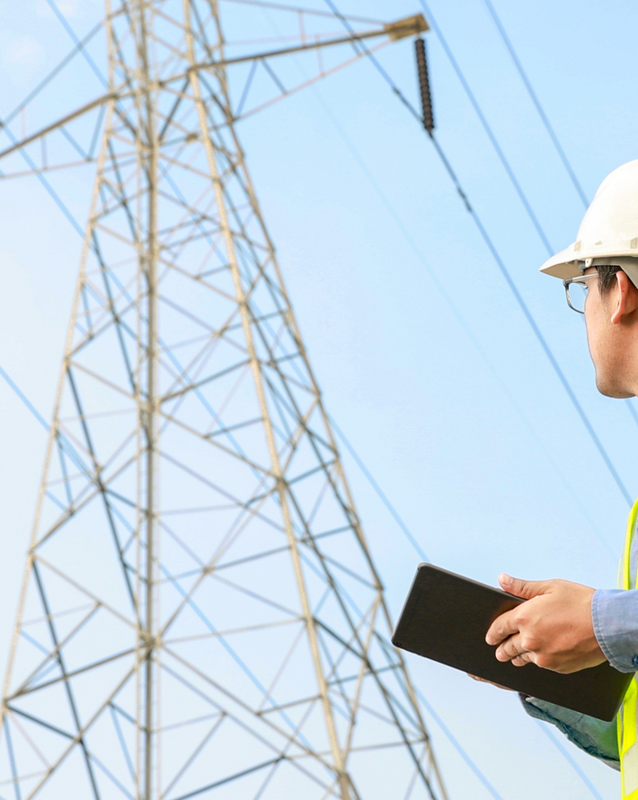
Wholesale prices of electricity and gas have surged as much as 15-fold since early 2021”
International Monetary Foundation, December 2022
Notes:
https://www.imf.org/en/Publications/fandd/issues/2022/12/beating-the-european-energy-crisis-Zettelmeyer
The cost of energy, particularly in Europe has placed tremendous pressure on businesses to reduce their power consumption or face shutdowns and project cancellations. Application infrastructure in the data center consumes a large amount of energy, and IT leaders like yourself are asking us regularly how they can take action now.

Slide 4
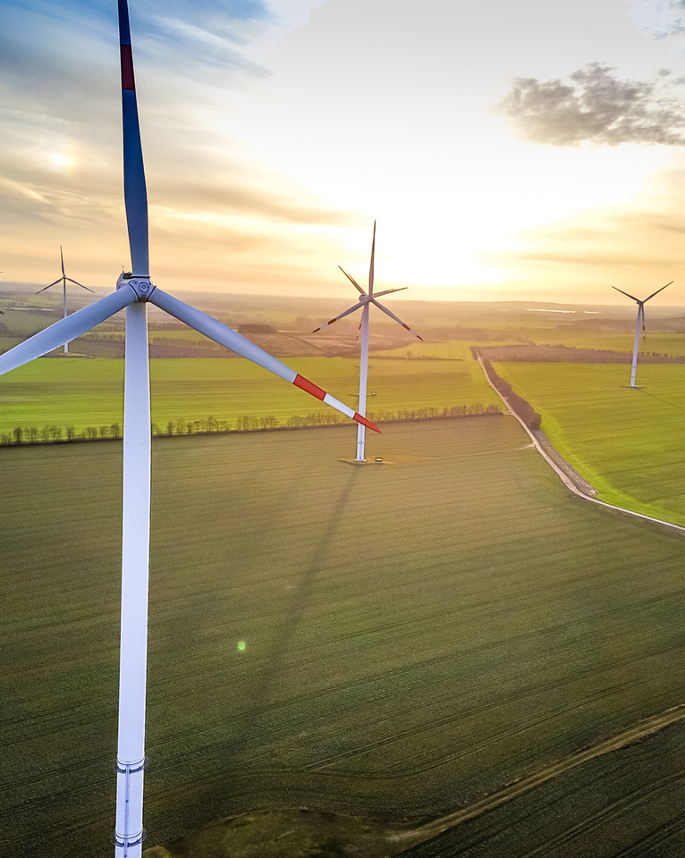
VMware’s technology has enabled customers to collectively avoid the consumption of 2.4 billion megawatts of energy”
IDC, Enabling More Agile and Sustainable Business Through Carbon-Efficient Digital Transformations. 2020
Notes:
https://octo.vmware.com/accelerating-decarbonization-of-world-digital-infrastructure/
https://www.vmware.com/content/dam/digitalmarketing/vmware/en/pdf/company/vmware-idc-whitepaper-2020.pdf
VMware has a long history reducing the energy consumption of IT infrastructure, making it much more efficient to run applications on your data center hardware. We continue to innovate in this area, and are here to help you with new strategies to address the rising cost of energy. Ultimately, we want to help you preserve your revenue generating application initiatives.

Slide 5
Recommendations to Reduce IT Energy Consumption
Audit for Waste and Resource Optimization
Offload to Data Processing Units (DPUs)
Replace On-Site Disaster Recovery with DRaaS
Notes:
There are three recommendations we have today to address this challenge.
The first is auditing for waste and resource optimization in your VMware infrastructure. This builds on the value of virtualization, taking resource optimization to a new level.
Next is offloading to specialized hardware called DPUs. This is a new capability, and one with a major impact on energy use.
Last is to shift your DR strategy to the public cloud, instead of running warm hardware. We make this incredibly easy to implement.
Let’s talk through each in a bit more detail.

Slide 6
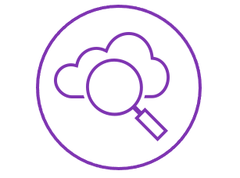
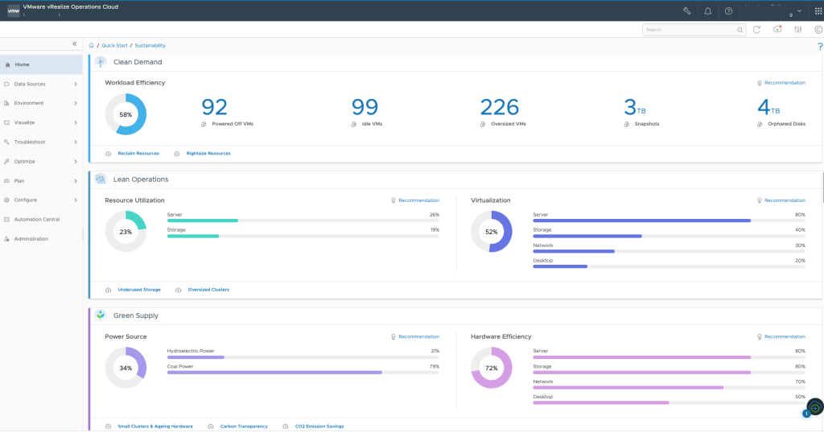

#1: Audit for Waste and Resource Optimization
VMware Aria Operations
Uncover waste and optimization opportunities in your VMware infrastructure by assessing:
Workload Efficiency
Resource Utilization
Virtualization Rate
Power Source
Hardware Efficiency
Scan to watch a demo:
Notes:
First, with VMware Aria Operations, you can assess your entire VMware infrastructure across any datacenter, public cloud, or edge environment for opportunities to lower power consumption. We surface these recommendations in our Sustainability dashboard. Here, you’ll find areas of waste, inefficiency and more, that you can adjust so that you don’t have unused resources consuming power.

Slide 7
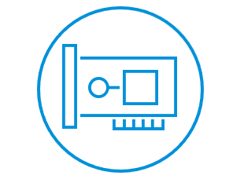
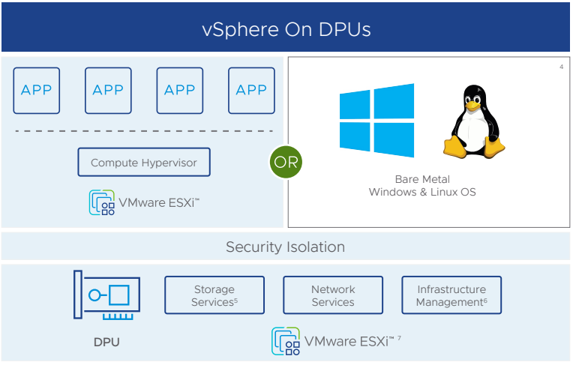

#2: Offload to DPUs
VMware vSphere Distributed Services Engine
Reduce power consumption by 29-45¹% when you offload to DPUs. Current offload capabilities include:
vSphere Distributed Switch
NSX Networking
NSX Distributed Firewall
Scan to watch a demo:
1 https://www.nextplatform.com/2022/11/03/economics-and-the-inevitability-of-the-dpu
Notes:
Next, is offloading to DPUs. These are a new class of Network Interface Card (NIC), called a smartNIC, which can run many of your infrastructure tasks. Think about it this way: In your current infrastructure, you have applications taking CPU cycles, and then you have management, security, and networking also consuming CPU and therefore power. Many of these services can be offloaded to a smartNIC, allowing you to reclaim CPU cycles on your servers. This can be scaled across your infrastructure, so that you end up needing 29-45% less hardware to run your apps. Partners such as NVIDIA make DPUs, and you can find the offload feature within vSphere, called the vSphere Distributed Services Engine.

Slide 8
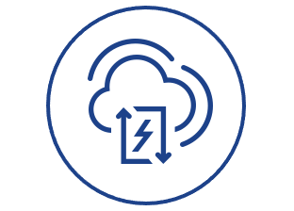
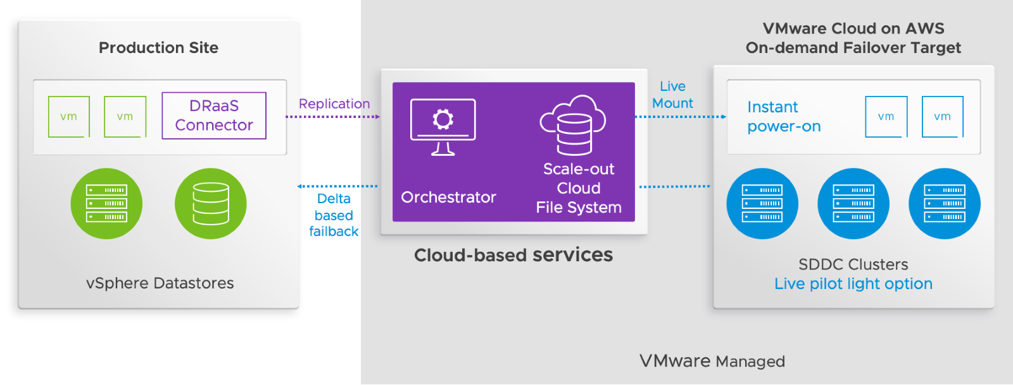

#3: Replace On-Site Disaster Recovery with DRaaS
VMware Cloud Disaster Recovery
Reduce the energy required to run DR by 87%¹ using DRaaS.
Deployment can be in two forms:
100% on-demand: workload resources spin up only when a failover event occurs.
Pilot-Light: maintains a small live footprint for business-critical apps at all times.
Scan to watch a demo:
1 https://blogs.vmware.com/virtualblocks/2021/08/02/reduce-dr-carbon-footprint/
Notes:
Last, is a pragmatic change to your DR infrastructure, especially if you have a hardware refresh coming up. Instead of running DR hardware, you can create a seamless hybrid cloud with VMware Cloud Disaster Recovery, which establishes your failover environment in a public cloud. This is not just a 1:1 switch in your failover location. VCDR is architected to use a much smaller footprint than on-prem DR, so you actually need much less infrastructure in the public cloud. We do this in 2 ways.
The first is a 100% on-demand model, which keeps your data static, and spins up your live environment only when you have a failover event.
The second is what we call a pilot-light implementation, which maintains a small live footprint for your business-critical apps, so you have near-real time recovery.
Either implementation removes the need to power hardware used for DR in your datacenter, and shifts to a highly efficient, cost-effective OpEx model in the public cloud.

Slide 9


VMware Cross-Cloud™ services
app Platform
CLOUD MANAGEMENT
Cloud and Edge Infrastructure
SECURITY AND NETWORKING
ANYWHERE WORKSPACE
Build and operate cloud native apps
Automate and optimize apps and clouds
Run enterprise apps anywhere
Connect and better secure apps and clouds
Access any apps on any device more securely
Run Enterprise Apps Anywhere
REDUCE ENERGY CONSUMPTION ACROSS CLOUDS
Audit for Waste and Resource Optimization
Offload to Data Processing Units (DPUs)
Replace On-Site Disaster Recovery with DRaaS
Notes:
All of these solutions work in the same way wherever you deploy VMware infrastructure. Cloud and Edge Infrastructure is one of the pillars of our Cross-Cloud services portfolio, giving you the ability to run your enterprise apps consistently, anywhere, with the lowest power consumption possible.
There are many other layers of standardization we can help you implement, from app development to management and security, which I encourage you to explore further.

Slide 10
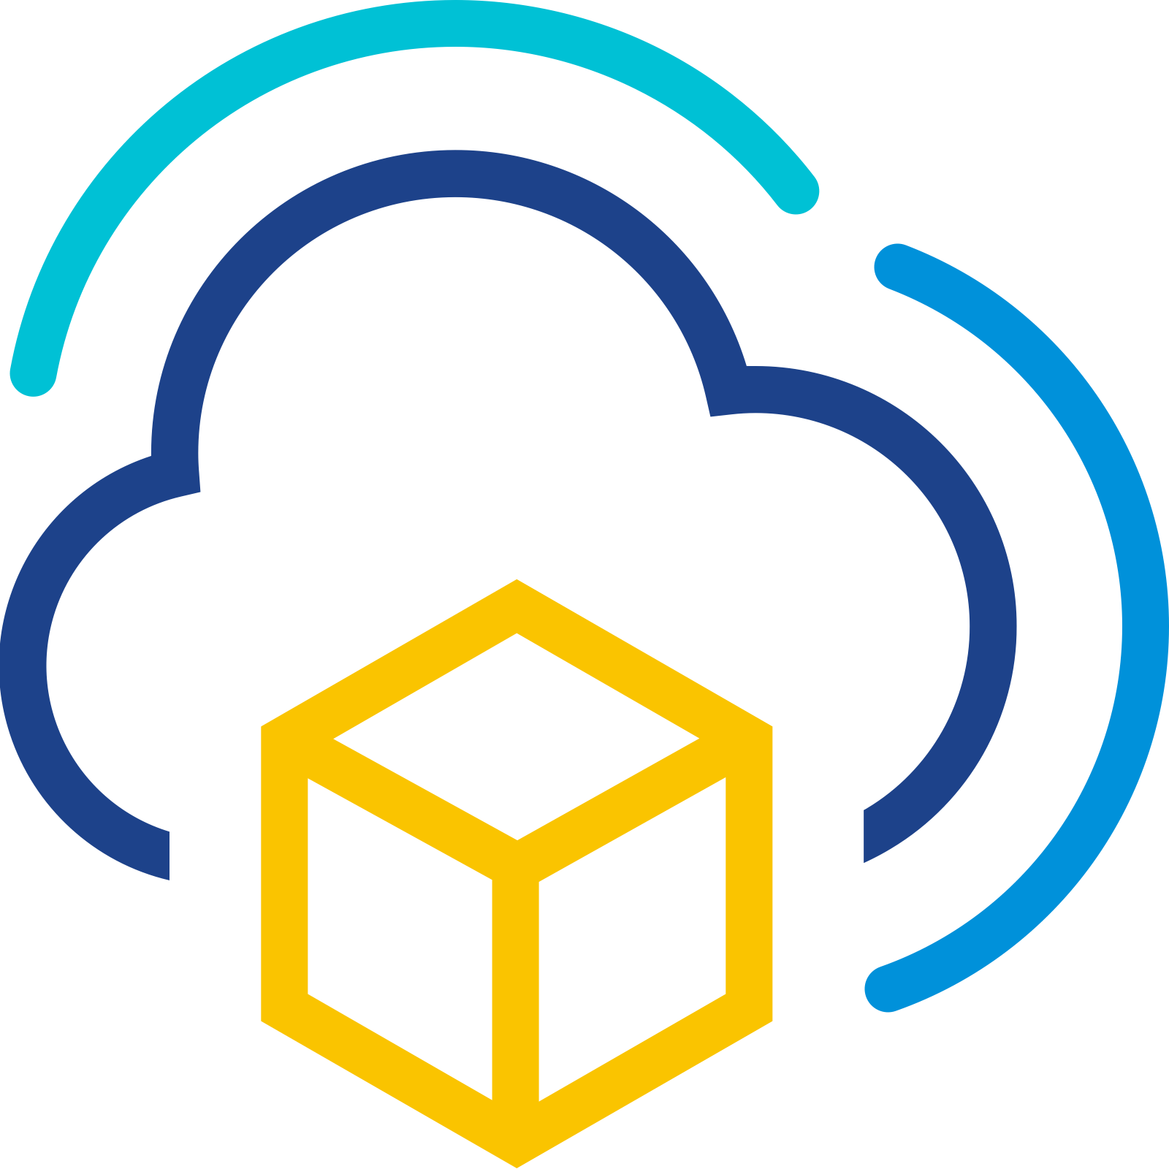

Next Steps
Resources and Additional Solutions
Resources
VMware Aria Operations
VMware vSphere Distributed Services Engine
VMware Cloud Disaster Recovery
Additional Solutions
Looking for more ways to lower both TCO and your carbon footprint?
Explore migration to VMware Cloud on AWS
Scan for more on this topic:
Notes:
To keep learning, check out the resource links on each product line here.
I’ll add that if you want to save money and have applications or entire datacenter locations targeted for the public cloud, the absolute fastest and most cost-effective path is to VMware Cloud. You can migrate your applications without any changes, and modernize them in the public cloud with any native service you want, from there. The flexibility and economics of this solution are unparalleled in the industry.

